Slide 1

Student MANAGEMENT SYSTEM
By
Souhardya Chakrabarti
001811701027
Under the guidance of
Prof.(Dr) Arunanshu Shekhar Kuar
Faculty of Engineering and technology JADAVPUR UNIVERSITY
Department of Production Engineering

Slide 2
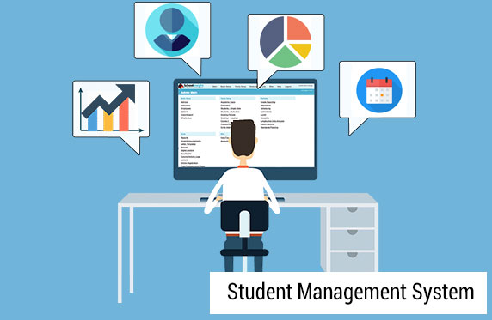

Slide 3
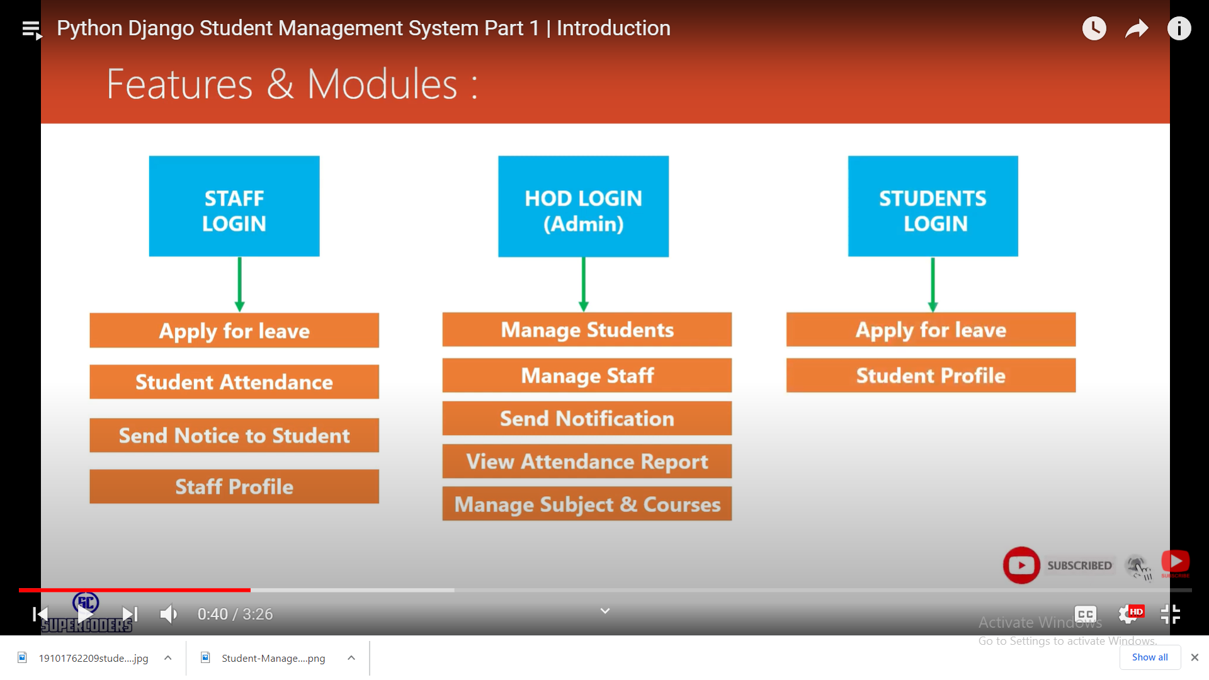

Slide 4
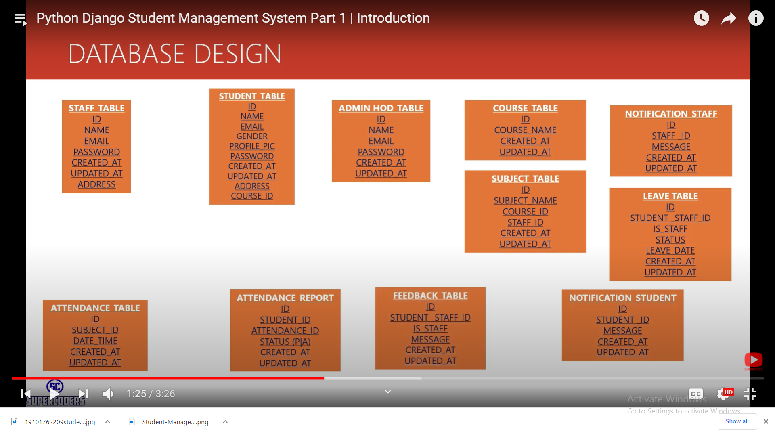

Slide 5
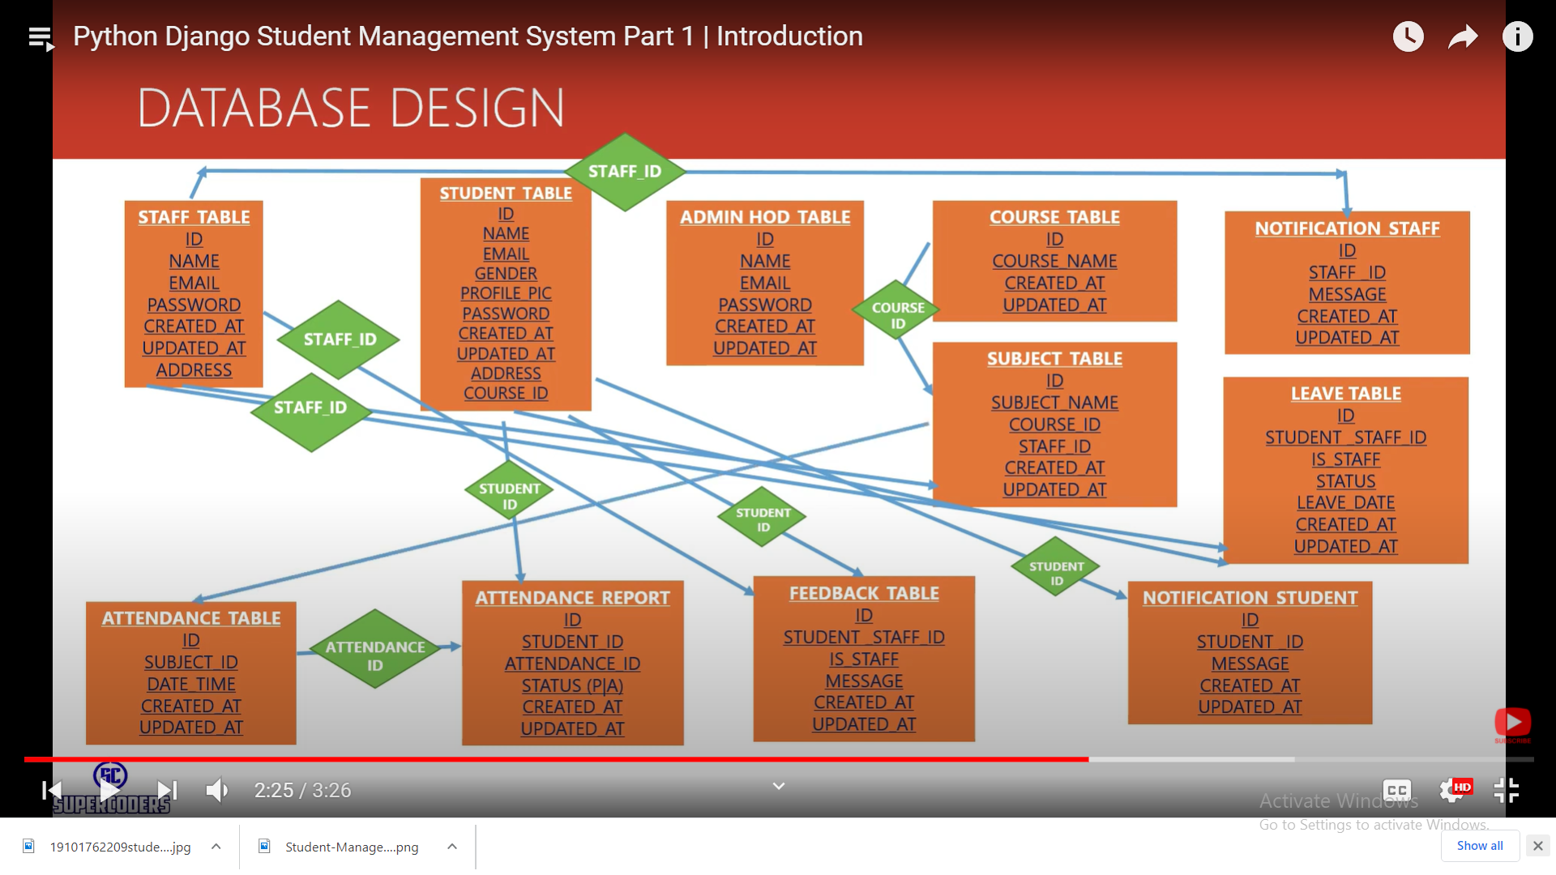

Slide 6
STUDENT WORKING MODULE
Login
Apply for leave
View His/Her attendance data
View His/Her marksheet
View/Edit profile
Send feedback
View all notifications
Join online classes(work in progress)
Logout

Slide 7
STAFF/PROFFESOR WORKING MODULE
Login
Apply for leave
Take attendance
View/Edit attendance data
Build/Edit Marksheet
View/Edit profile
Send feedback
View all notifications
Create online classes(work in progress)
Logout

Slide 8
HOD/ADMIN WORKING MODULE
Login
Add/remove/edit Students
Add/remove/edit Staffs
View all attendance data
View all Marksheet
Add/remove/edit Courses
Add/remove/edit Subjects
8. Send Notification
9. View/Reply to Feedbacks
10. Grant/Dismiss Leaves
11. Logout

Slide 9
Thank You and now lets head to the website

